Slide 1

BRAND GUIDELINES

Slide 2


Welcome To The Qyrus Partner Ecosystem
As a valued Qyrus partner, you play a critical role in amplifying our shared vision: empowering the world to test better, faster, and smarter. This guide ensures that all brand expressions—logos, content, visuals, and messaging are consistently and correctly applied across your materials.
Your Responsibility
You are legally accountable for the claims and creative assets you use. All branding materials must follow Qyrus’ guidelines and intellectual property laws.
Qyrus Brand Guidelines
01

Slide 3

Partner Responsibility & Brand Integrity
Creating Success Together
Copyrights
What is the correct way to refer to Qyrus?
Partner Program
Content Creation Guidelines
Brand Overview
Logo & Representation
Logo’s Usage
Do’s & Don’ts
Typography
Weight & Styles
Color Palette
Verbal Identity
Tone of Voice
Co-Branding Rules
Event Branding
Content Guidelines
Social Media Standards
Table of
Contents
Legal & Contact Info
Qyrus Brand Guidelines
02

Slide 4



Partner Responsibility & Brand Integrity
As a Qyrus partner, you are entrusted with our most powerful asset — our brand.
Adherence to the Qyrus Partner Brand Guidelines and all applicable intellectual property laws is essential when using Qyrus names, logos, and creative assets
These guidelines apply across all branding and promotional content including:
Digital and print collateral
Social media and press releases
Event materials and co-branded assets
The Qyrus Partner Brand Guidelines are subject to periodic updates. It is your responsibility to ensure all assets remain compliant with the current legal and visual identity standards.
Qyrus Brand Guidelines
03

Slide 5
Creating Success Together
As a Qyrus partner, you are entrusted with our most powerful asset — our brand. Compliance with the Qyrus Partner Brand Guidelines and all applicable intellectual property laws is essential in your use of Qyrus names, logos, and creative assets.
The Qyrus Partner Brand Guidelines are subject to periodic updates. It is your responsibility to ensure that all branding and promotional content including digital, print, social, event collateral, press releases, and co-branded assets are fully aligned with the current Qyrus legal and visual identity standards.
Qyrus reserves the right to request modifications or removal of any partner content that fails to meet brand expectations.
While we strive to build positive and empowering partnerships, Qyrus may require changes to product names, marketing content, social media assets, booth designs, presentations, or co-branded creatives to maintain brand consistency.
Any costs associated with rebranding or updating materials are the sole responsibility of the partner. Failure to comply may impact partnership standing or participation in Qyrus-led events potentially leading to removal without refund.
Let’s create success authentically and consistently together.
Qyrus Brand Guidelines
04

Slide 6
Copyrights
All Qyrus content including visual identity, website content, marketing materials, video content, and all supporting digital assets—is protected under copyright law. These materials are the property of Qyrus Inc.
Unless otherwise approved in writing, partners may not use, replicate, or redistribute any Qyrus-owned asset for external or commercial purposes.
Qyrus Brand Guidelines
05

Slide 7
What is the correct way to refer to Qyrus?
When referring to Qyrus, the context of the reference determines the correct articulation.
Articulation
Context
Example
Qyrus Inc.
Use this when referring to Qyrus as an entity in a legal line (for contracts or official filings).
“Qyrus Inc. is a test automation platform designed for modern enterprise testing needs.”
Qyrus
Use this when referring to Qyrus as a company in narrative or prose.
“We’ve partnered with Qyrus to streamline our testing processes.”
Qyrus®
Use this when referring to Qyrus as a product or brand. The word must include the ® symbol and be followed by a generic noun.
“With Qyrus® test automation, our time to release has dropped by 40%.”
Qyrus Brand Guidelines
06

Slide 8



Content Creation Guidelines
Qyrus Brand Guidelines
08

Slide 9

Our Mission
Brand
Overview
Qyrus = Quality + Intelligence + Speed + Simplicity
We exist to democratize software testing with intuitive, no-code solutions that scale at the speed of digital.
Our Mission
Make testing and compliance perform at the speed of agile using intelligent automation.
Our Voice
Credible. Confident. Simplified. Relevant.
Qyrus Brand Guidelines
09

Slide 10



Logo & Representation
Represents focus on ‘QUALITY’
Qyrus is derived from the Greek Word [Keh ruhs] Caeru.
It means opportunity and luck – we want to bring both to our employees, partners, and clients.
Our goal is to make testing better, faster and smarter. We want to help businesses test at the speed of digital through no-code AI solutions Our logo is designed to encapsulate this message.
Represents focus on ‘SPEED’
‘i’ represents focus on ‘INTELLIGENCE’
‘S’ represents focus on simple, smart, scalable and secure
Symbolic of the expansive ‘DIGITAL WORLD’ that Qyrus impacts
Qyrus Brand Guidelines
10

Slide 11




Logo’s Usage
Primary Logo
Use the full Qyrus logo in color on light backgrounds.
Monochrome Version
Use the white logo on dark or colored backgrounds.
Exclusion Zone
A safe area, or clear space, around the logo must be respected. This space is measured by the size of the uppercase “Q” in “QYRUS” surrounding all four sides
Minimum Size
40px height minimum for all digital usage.
Qyrus Brand Guidelines
11

Slide 12
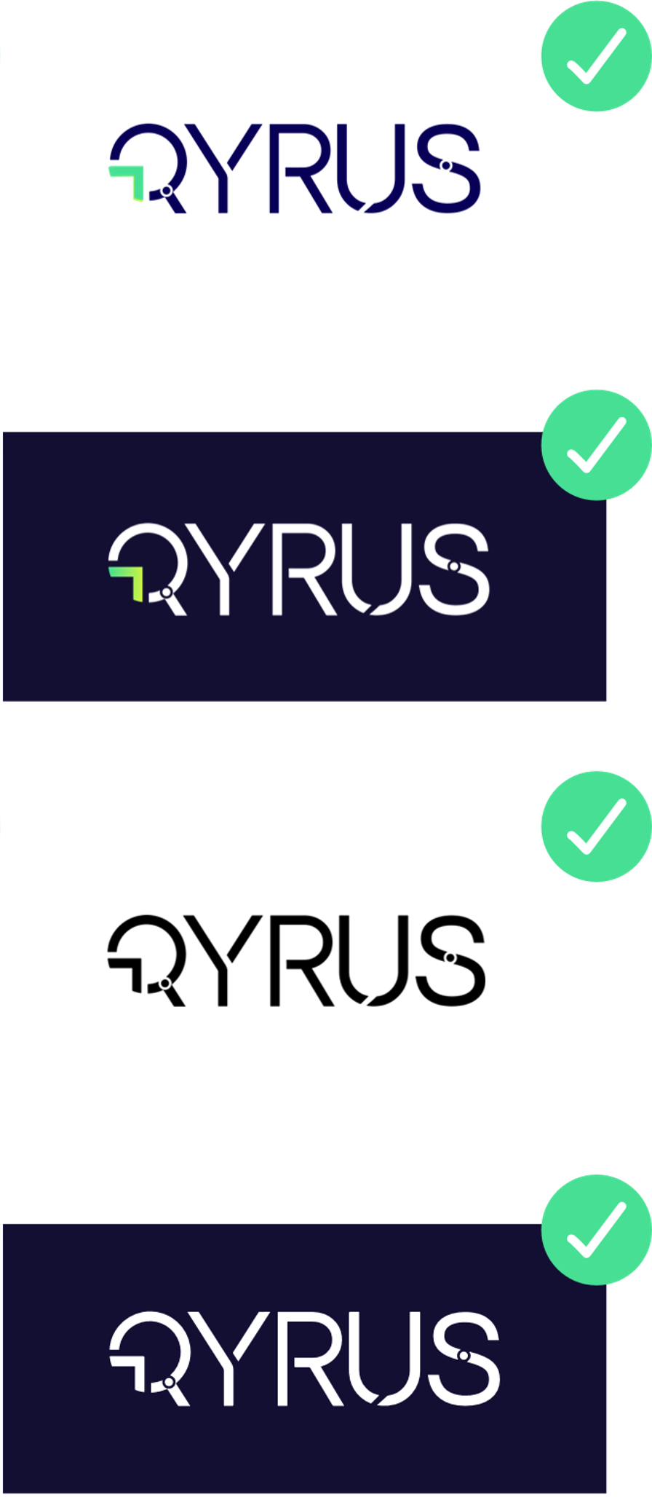
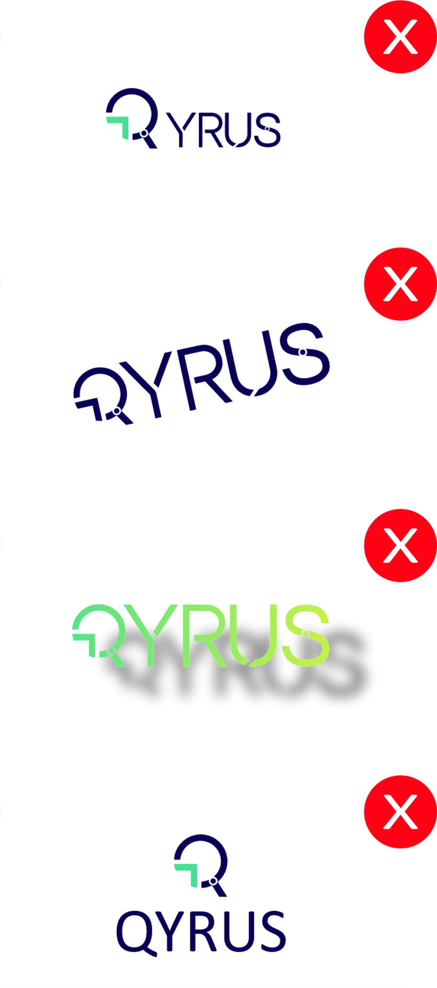
DO’S
Use only approved partner assets
Link to official Qyrus resources & stats
Use Qyrus color palette correctly
Create your own event content referencing Qyrus
DON’TS
Modify or distort Qyrus logo
Claim outdated or unverifiable stats
Add shadows, outlines, or low-contrast backgrounds
Copy Qyrus videos, decks, or logos without permission
Qyrus Brand Guidelines
12

Slide 13



Typography
Consistency is key:
Avoid mixing in new fonts or altering default tracking/leading.
Qyrus Brand Guidelines
13

Slide 14
Weight & Styles
Title
Calibri Bold
48pt – 72pt
Quality + Intelligence + Speed + Simplicity
Consistency is key:
Avoid mixing in new fonts or altering default tracking/leading.
Subtitle
Calibri Regular
24pt – 36pt
Make testing and compliance perform at the speed of agile using intelligent automation.
Body Copy
Calibri Italic
10pt – 14pt
Make testing and compliance perform at the speed of agile using intelligent automation.
Highlighter
Calibri Italic
14pt – 18pt
Make testing and compliance perform at the speed of agile using intelligent automation.
Qyrus Brand Guidelines
14

Slide 15
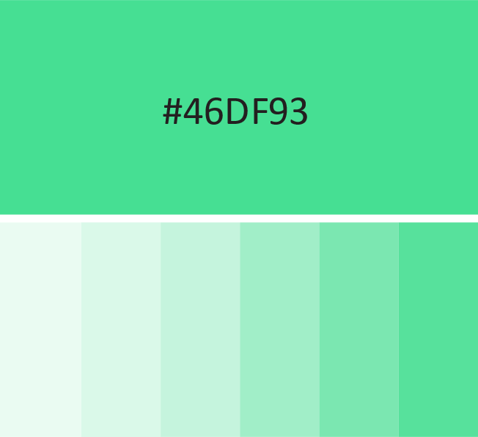
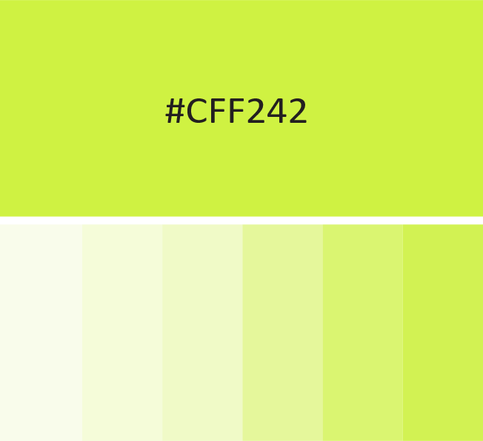
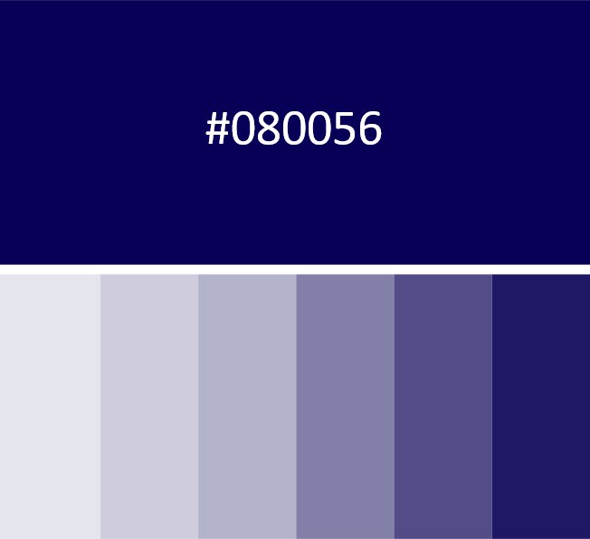
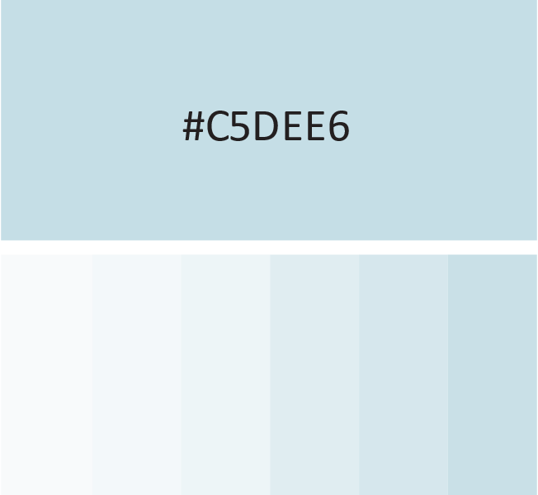
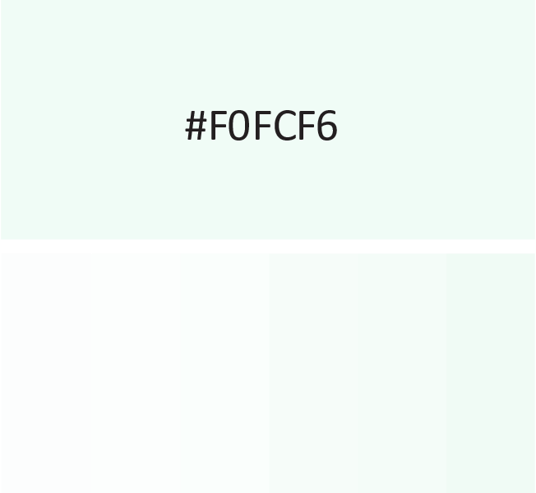
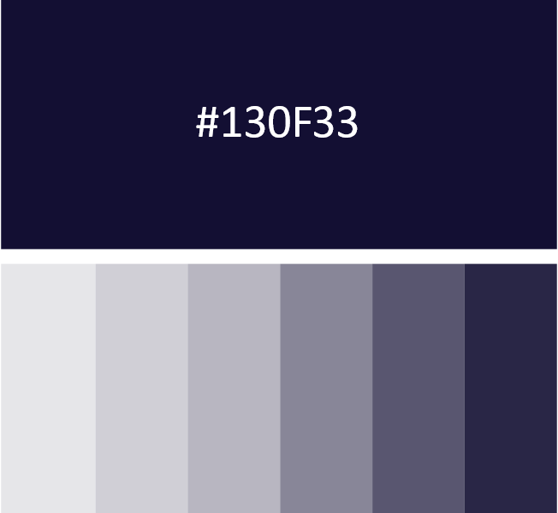
Primary Colors
Color Palette
Use these thoughtfully and never alter brand-approved shades
CMYK : 60 : 0 : 61 : 0
CMYK : 24 : 0 : 88 : 0
CMYK : 100 : 100 : 24 : 40
RGB : 70: 223 : 147
RGB : 207: 242 : 66
RGB : 8 : 0 : 86
Secondary Colors
CMYK : 21 : 4 : 7 : 0
CMYK : 5 : 0 : 4 : 0
CMYK : 95 : 93 : 46 : 60
RGB : 197: 222 : 230
RGB : 240: 252 : 246
RGB : 19: 15 : 51
Qyrus Brand Guidelines
15

Slide 16
Verbal Identity
Qyrus as a person
If Qyrus was a person, how’d you describe it.
Purposeful
Empowering
Reliable
Resilient
Agile
Intelligent
Adaptable
Flexible
Qyrus Brand Guidelines
16

Slide 17
Our Mission
Tone of Voice
Qyrus
Tone of voice is intended towards lending meaning and credibility to all that we put forth. There should be a right balance between purpose, knowledge, insight-sharing, and opinions in a truly engaging way that resonates well with our large audience.
Keeping our brand attributes in mind, we strive to be storytellers. We aim to engage and connect in a meaningful way. We are impactful, memorable, and most importantly relevant.
Confident
Credible
Informative
Relevant
Simplified
Qyrus Brand Guidelines
17

Slide 18
Co-Branding Rules
When creating materials with Qyrus assets:
When referring to Qyrus, the context of the reference determines the correct articulation.
Use your own logo clearly alongside the Qyrus logo
Maintain equal prominence and spacing
Include a short clarifying line like “in partnership with Qyrus”
NEVER
Merge your logo into the Qyrus logo
Use Qyrus logos in your product branding
Modify Qyrus logos or visual elements
Qyrus Brand Guidelines
18

Slide 19
Event Branding
All events co-hosted or sponsored by Qyrus must use:
Original content co-branded as per above Co-Branding Rules
Accurate product descriptions (no copy-pasting our website content)
Compliant Booth Design Must:
Use white/light backgrounds
Feature official logos
Cite all claims and awards properly
Qyrus Brand Guidelines
19

Slide 20
Content Guidelines
Key Claims to Use
Approved Phrases
“75% reduction in automation efforts”
“10X faster testing time”
“Auto-discovers 95% of test cases”
“Powered by Qyrus”
“Test at the speed of digital”
“Codeless. Continuous. Cloud-based.
All data must be referenced from official Qyrus materials.
Qyrus Brand Guidelines
20

Slide 21
Social Media Standards
Handles, and Mentions
Don’t create:
Use your own brand handle only
Tag @Qyrus when mentioning us
❌ Qyrus-branded social media handles ❌ Imitation Qyrus profiles or logos
Hashtags
These are core to Qyrus' identity and should be used consistently across content.
#PoweredByQyrus, #NoCodeTesting,
#SmarterTesting, #QyrusPlatform, #QyrusPartner
Qyrus Brand Guidelines
21

Slide 22
Legal &
Contact Info
All Qyrus brand assets are protected under copyright laws globally.
Need help with compliance? 📩 marketing@qyrus.com
Qyrus Brand Guidelines
22

